Slide 1


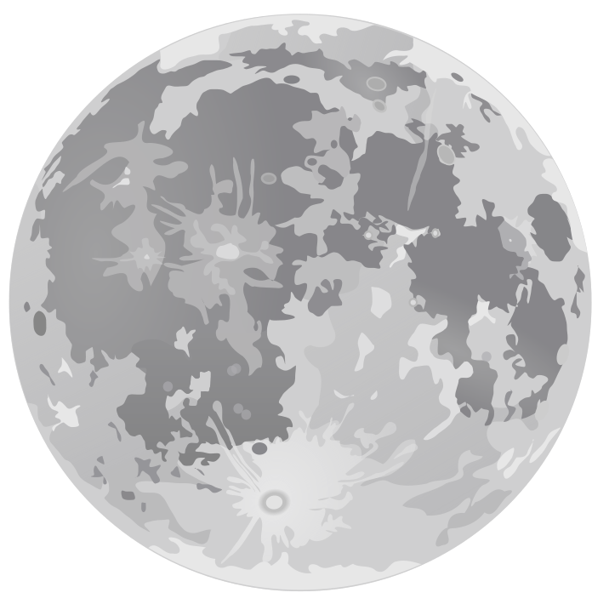
Detect Moon Pot-hole
FINAL REVIEW
By
Aman Kumar 20MIA1144
Kamna V 20MIA1053
Palak Deep Kaur 20MIS1162

Slide 2


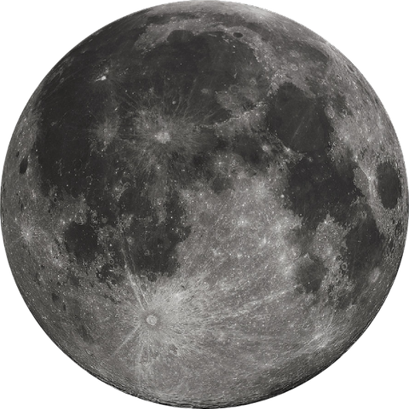
Introduction
To make the image clear we use image processing filters like 2D, image sharpening, and noise filters.
YOLO the architecture is splitting the input image in mxm grid.
For each grid generation 2 bounding boxes and class probabilities for those bounding boxes.

Slide 3
Techniques used
Image processing filters like 2D, image sharpening and noise filters
Python and its libraires like Matplotlib, NumPy,
openCV, torch etc. for this project.
,
Google Colab IDE environment.
For Computer Vision we explored algorithms like YOLO

Slide 4

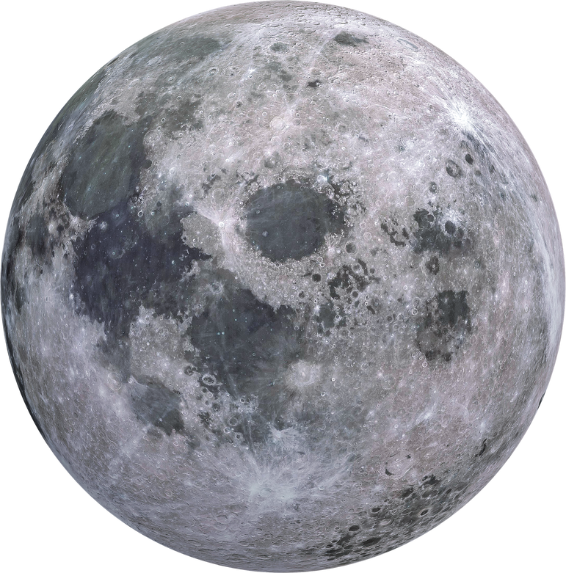
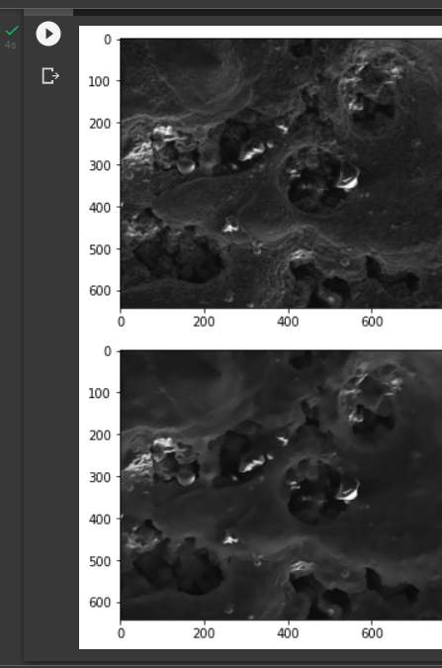
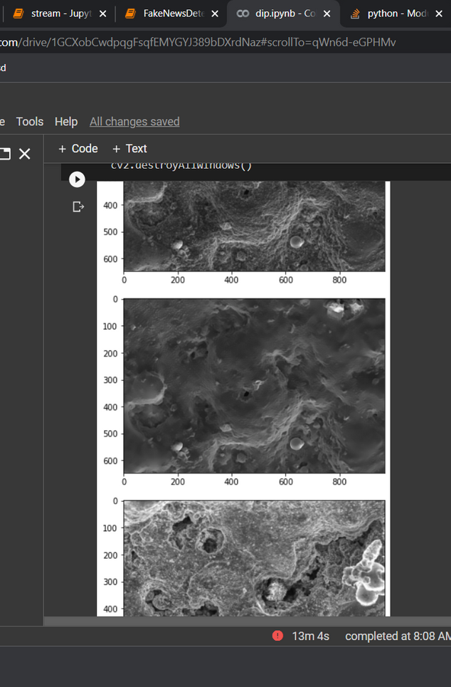
Image processing implementation
Reducing the noise for
better recognization

Slide 5
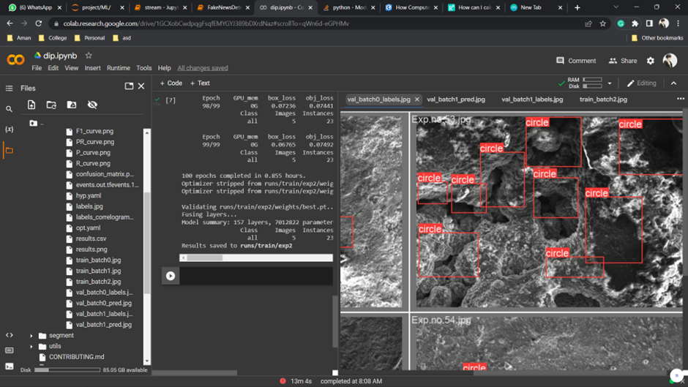
YOLO Algo Implementation

Slide 6
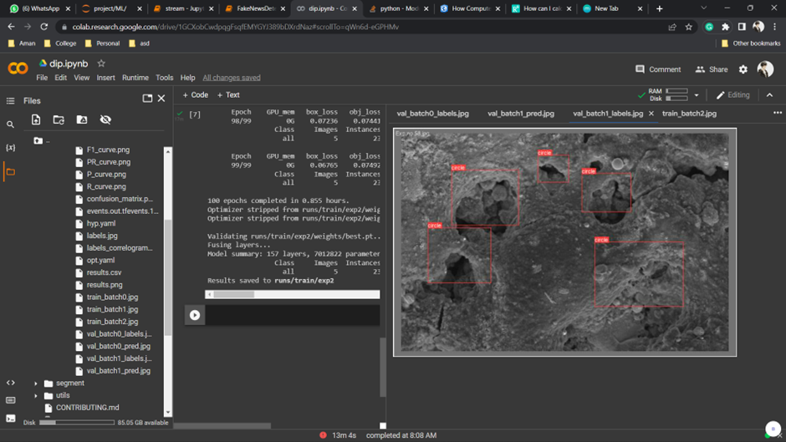

Slide 7

Without checking accuracy

Slide 8
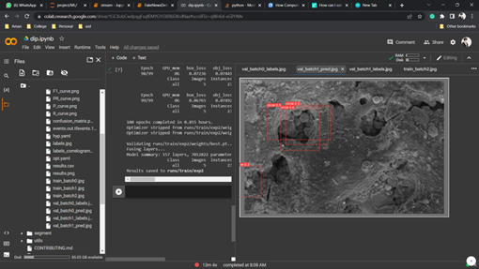
Accuracy after applying YOLO

Slide 9
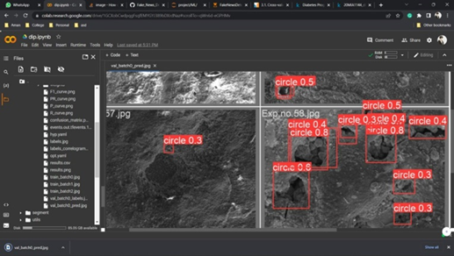
Accuracy after applying Image Processing

Slide 10
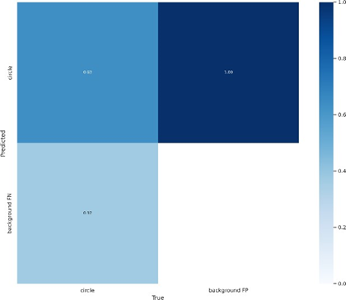
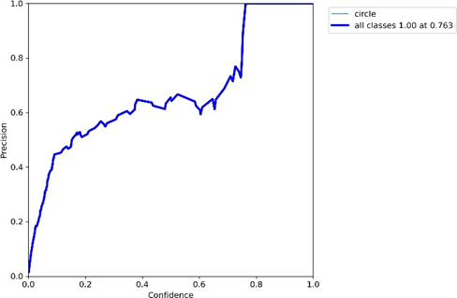
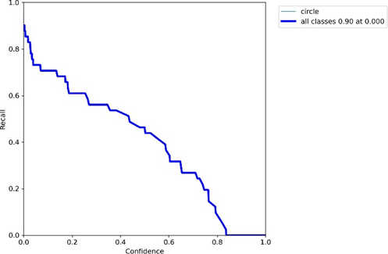
Statistics of the Model
Confusion matrix
Recall vs Confidence graph
Precision vs Confidence graph

Slide 11



